Slide 1




NEXT GEN EMPLOYABILITY PROGRAM
Creating a future-ready workforce
Team Members
AVS College of Technology ,Salem.
Student Name : Manimegalai V
Student ID :623521104032
Notes:
1

Slide 2

CAPSTONE PROJECT SHOWCASE
Project Title
Building Bus Reservation System using Python and Django
Abstract | Problem Statement | Project Overview | Proposed Solution | Technology Used | Modelling & Results | Conclusion

Slide 3
Abstract
The bus reservation system is a vital component of modern transportation management, facilitating efficient booking, scheduling, and seat allocation for passengers. Through digital platforms, it streamlines the process, offering convenience and flexibility to travelers while optimizing operational logistics for service providers. This abstract explores the significance of such systems in enhancing the overall travel experience, promoting accessibility, and maximizing resource utilization within the bus transportation sector.
Source :

Slide 4
Problem Statement
The problem statement for a bus reservation system focuses on addressing inefficiencies in traditional booking methods, such as long queues, manual ticketing, and limited accessibility. It aims to develop a digital platform that streamlines the reservation process, enhances user experience, optimizes seat allocation, and improves overall operational efficiency for both passengers and service providers.
Source :

Slide 5
Project Overview
The bus reservation system project aims to create a digital platform that streamlines the booking process for bus travel, enhancing convenience for passengers and efficiency for service providers. Utilizing modern technology, the system will enable users to browse routes, select seats, and make secure payments online. It will incorporate features such as real-time seat availability updates, route mapping, and integration with payment gateways. The project also includes developing an admin panel for managing routes, buses, fares, and customer data. Additionally, the system will prioritize user experience with an intuitive interface and responsive design for mobile accessibility. Through this project, we aim to revolutionize bus ticketing, making it more accessible, user-friendly, and efficient for all stakeholders involved.
Source :

Slide 6
Proposed Solution
.
The proposed solution involves developing a user-friendly web and mobile application for bus reservation, enabling passengers to easily search, book, and manage their trips. Real-time seat availability updates and secure payment gateways will ensure smooth transactions. An intuitive admin panel will empower operators to efficiently manage routes, buses, and fares. Integration of GPS tracking will provide passengers with live bus tracking for enhanced convenience. By implementing this solution, we aim to revolutionize the bus reservation experience, making it seamless and efficient for both passengers and operators.
Source :

Slide 7
Booking and Payment Processing:
The booking and payment processing system will be seamlessly integrated into the bus reservation platform, allowing users to select their desired route, date, and seat preference before proceeding to payment. Users will have the option to pay securely using various methods such as credit/debit cards, digital wallets, or other online payment gateways. The system will employ encryption and secure sockets layer (SSL) technology to ensure the safety of users' financial information. Once payment is confirmed, users will receive instant booking confirmation via email or SMS, with the details of their reservation. Additionally, the system will provide users with the flexibility to modify or cancel their bookings within a specified timeframe, with appropriate refund processes in place.
Source :

Slide 8
Booking Management:
The booking management system streamlines the reservation process with real-time updates on seat availability, intuitive user interfaces, and seamless integration with secure payment gateways. It empowers users to effortlessly modify or cancel bookings while providing operators with comprehensive tools for monitoring and managing reservations. Automated notifications and dedicated customer support ensure a smooth booking experience, while robust security measures safeguard user data.
Source :

Slide 9


Technology Used
Front-end
Back-end
Source :

Slide 10
Modelling & Results
The modelling process involves designing algorithms to optimize seat allocation, predict demand, and enhance route planning. Results show increased efficiency in seat utilization, reduced instances of overbooking, and improved customer satisfaction. Through data analysis and machine learning techniques, the system continuously refines its algorithms, leading to more accurate predictions and better resource allocation over time.
Source :

Slide 11
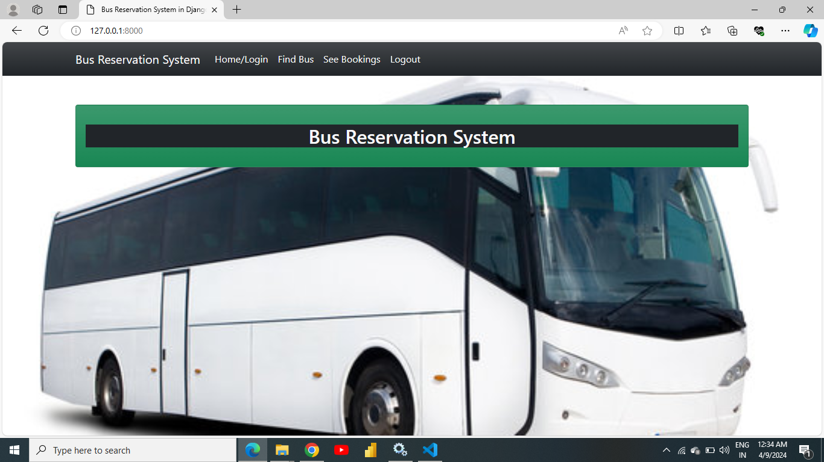
Homepage

Slide 12
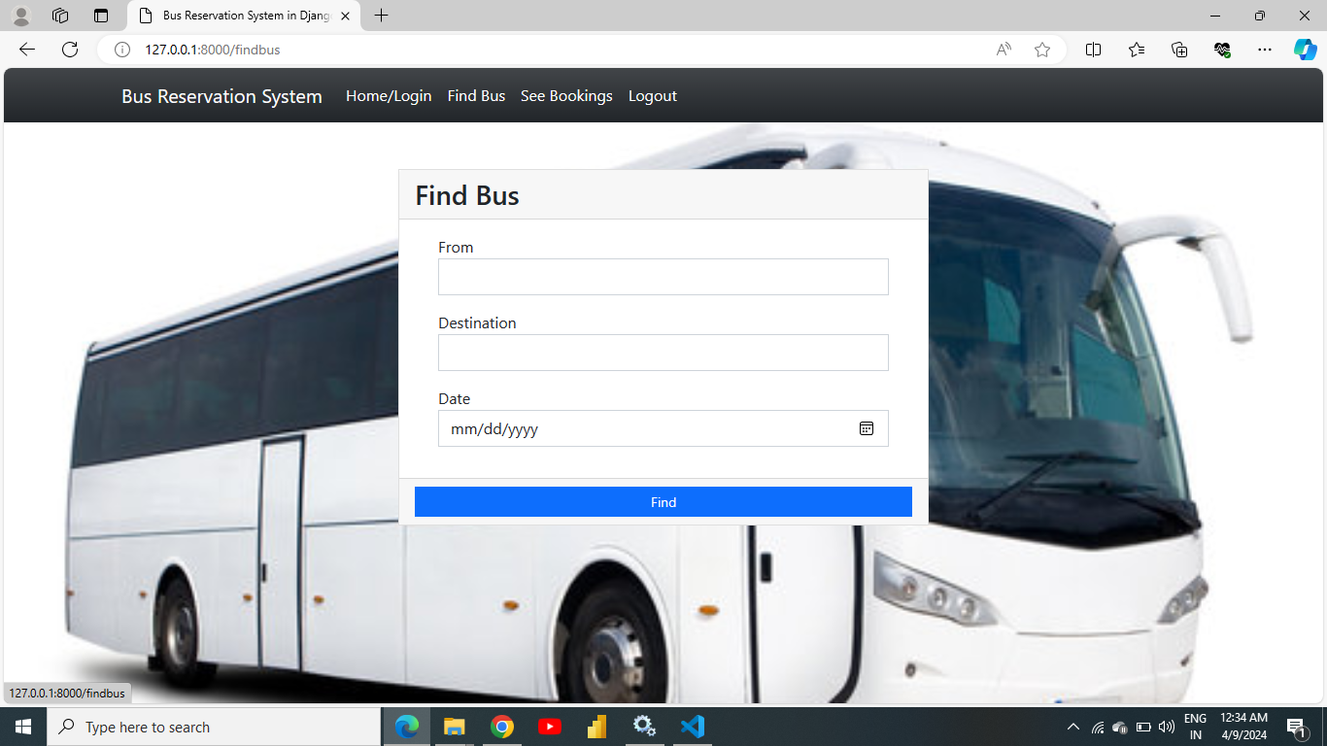
About-Us-Page

Slide 13
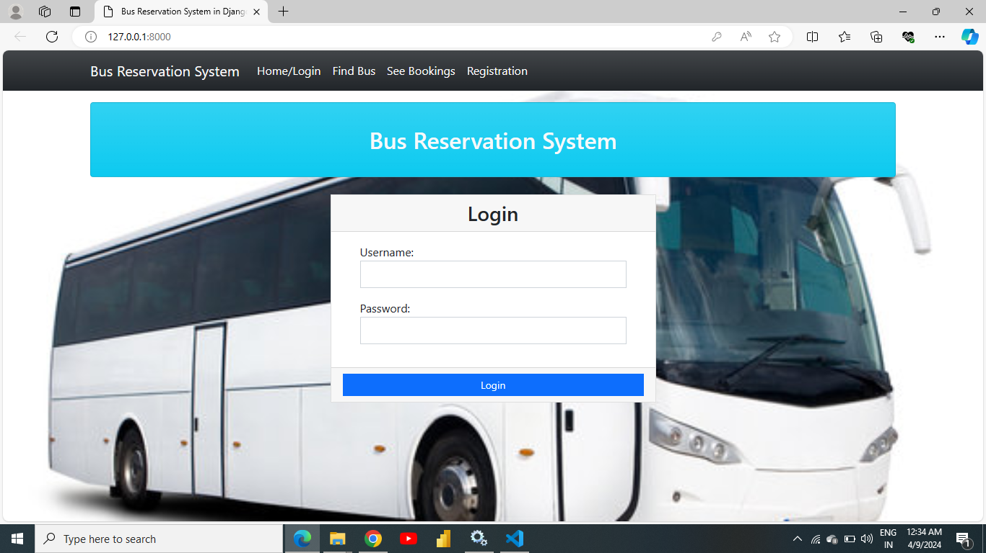
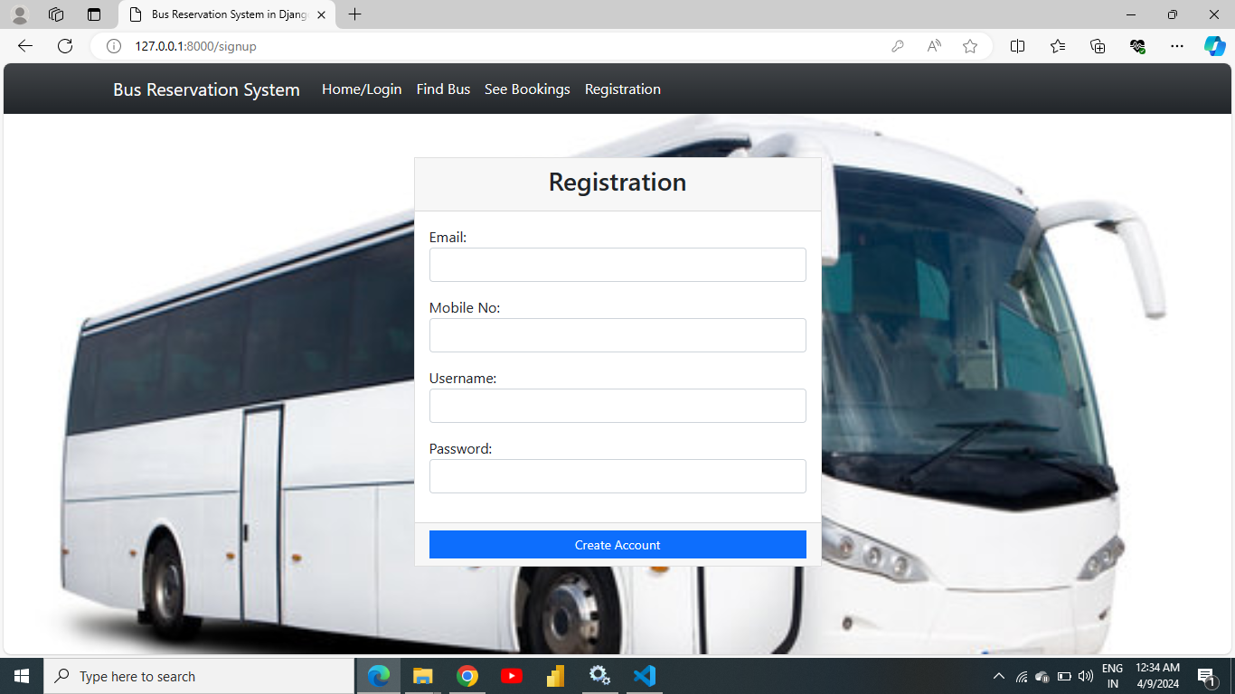
Login and Registration Page

Slide 14
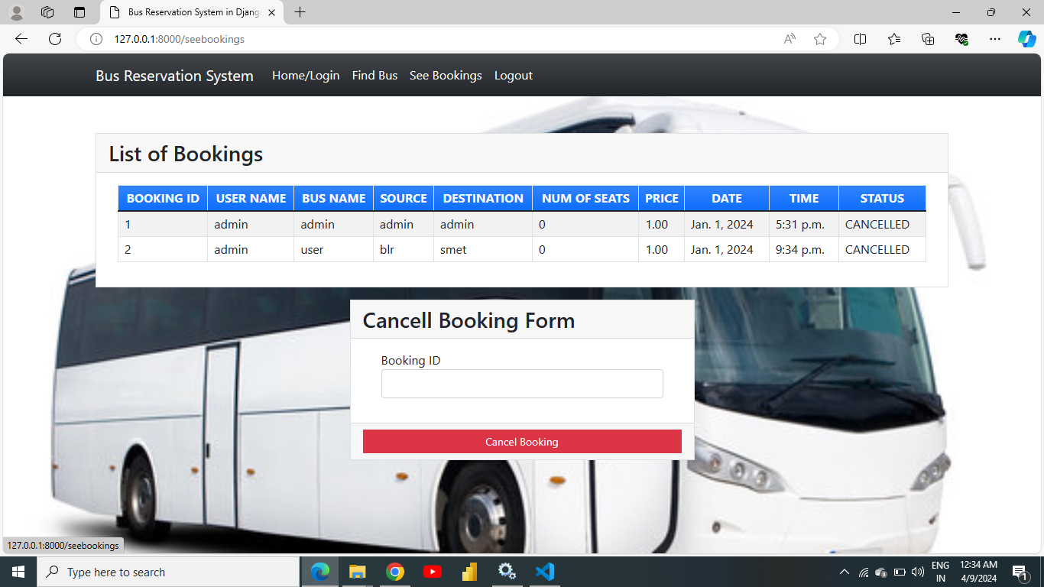
Departments-Page

Slide 15
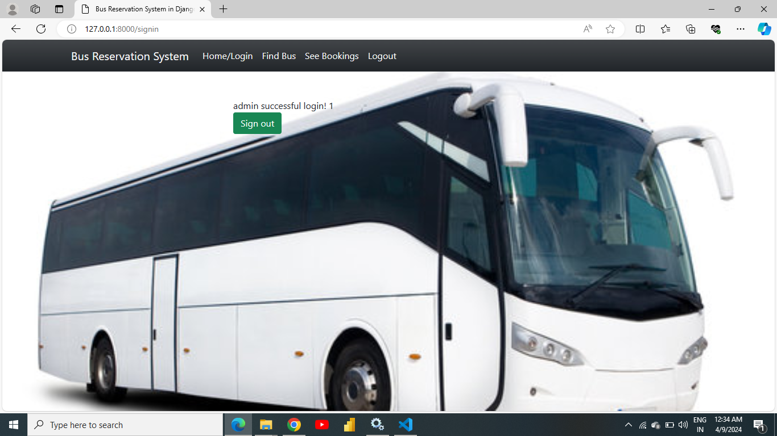
Blog-Page

Slide 16
Future Enhancements:
1. Enhanced predictive analytics for better demand forecasting.
2. Integration of AI-powered chatbots for customer support.
3. Implementation of dynamic pricing strategies.
4. Expansion of the platform to include multi-modal transportation options.
5. Incorporation of sustainability metrics into route planning.
6. Introduction of loyalty programs and personalized offers for frequent travelers.
7. Integration of biometric authentication for enhanced security.
10. Introduction of virtual reality experiences for pre-trip planning and destination exploration.

Slide 17
Conclusion
In conclusion, the bus reservation system represents a significant advancement in transportation management, offering convenience and efficiency to both passengers and service providers. Through streamlined booking processes, real-time updates, and secure payment options, it has transformed the travel experience. The system's predictive analytics and robust infrastructure lay the foundation for future enhancements, ensuring continuous improvement in service quality. By embracing technological innovation and customer-centric design, this solution sets a precedent for modernizing public transportation systems worldwide. As we move forward, collaboration and innovation will drive further improvements, making travel more accessible, sustainable, and enjoyable for all.
Source :

Slide 18
Thank You!
Notes:
Thank You !!

